Slide 1


Hands-On Practical Using Generative AI for MBA Students
This hands-on workshop will equip you with the skills and knowledge to confidently navigate the rapidly evolving world of Generative AI and apply it to real-world business challenges.
by JAYESH JAYANAND

Slide 2
Understanding Generative AI
Capabilities
Limitations
Explore the power of Generative AI to create new content: text, images, code, music, and more.
Examine the current limitations and biases inherent in generative AI models and understand their potential risks.

Slide 3




Generative AI in Business
Product Innovation
Data Analysis
Learn how generative AI can be used to create new products, services, and marketing campaigns.
Discover how generative AI can be used to identify trends, insights, and opportunities from large datasets.
Personalized Experiences
See how generative AI can be used to create personalized experiences and improve customer satisfaction.

Slide 4



Strategic Thinking with Generative AI
Identify Opportunities
1
Develop a framework for identifying opportunities to leverage generative AI in your industry.
Develop Strategies
2
Learn how to develop strategies for implementing generative AI solutions within your organization.
Evaluate Impact
3
Learn how to evaluate the potential impact of generative AI on your business.

Slide 5

Practical Applications of Generative AI
Text Generation
Image Creation
Gain hands-on experience with text-generating models for creating marketing copy, reports, and presentations.
Learn how to use AI models to create images for websites, marketing materials, and social media.
Code Generation
Explore the use of generative AI for automating tasks, improving code efficiency, and reducing development time.

Slide 6
Ethical Considerations and Risks
Bias and Fairness
Privacy and Security
Misinformation and Deception
Understand how biases can be embedded in generative AI models and learn how to mitigate them.
Explore the potential risks to privacy and security associated with using generative AI.
Examine the potential for generative AI to be used for creating misinformation or for deceptive purposes.

Slide 7
Hands-On Prototyping and Strategy
Develop Prototypes
1
Gain hands-on experience in building generative AI prototypes using industry-standard tools.
Write Strategy Memos
2
Learn how to communicate the potential value of generative AI through persuasive strategy memos.
Present Findings
3
Practice presenting your findings and recommendations to a business audience.

Slide 8
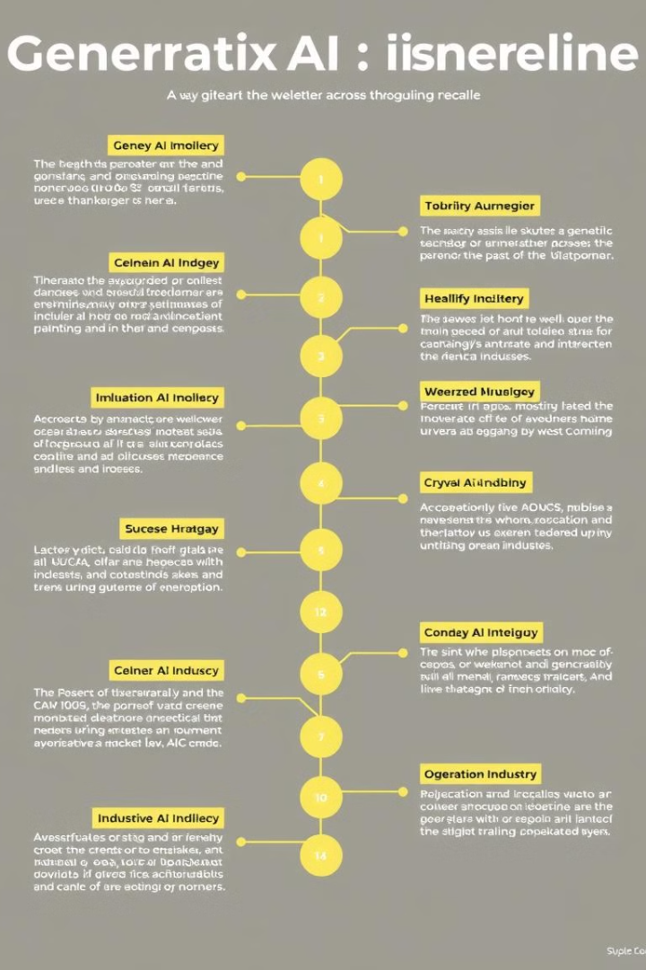
Generative AI Deployment
1
Retail
Analyze how generative AI is being used in the retail industry for personalized recommendations and targeted advertising.
2
Healthcare
Explore the use of generative AI for drug discovery, disease diagnosis, and patient care.
3
Finance
Discover how generative AI is transforming the finance industry with applications for fraud detection and risk management.

Slide 9

Policy for Responsible Use
1
2
Transparency
Governance
Develop policies for transparent and accountable use of generative AI.
Establish governance structures and oversight mechanisms for generative AI deployment.
3
Education
Promote awareness and education about the ethical implications of generative AI.

Slide 10
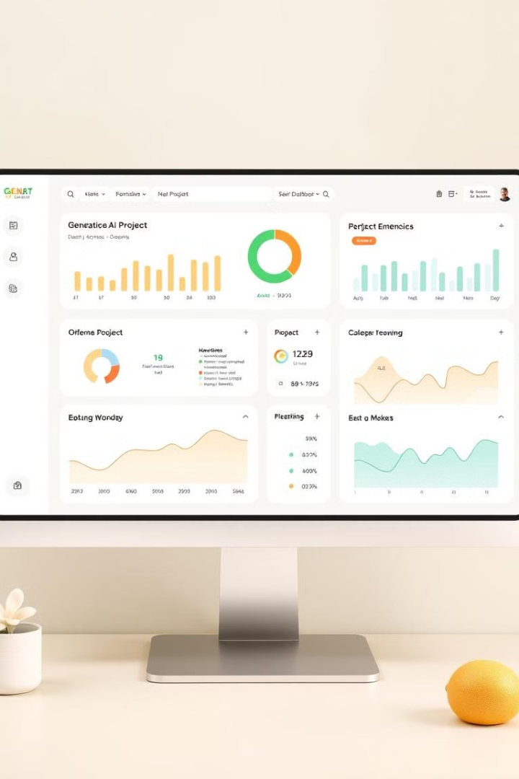
Proof-of-Concept Project
Showcase a proof-of-concept or prototype that demonstrates the impact of generative AI on a specific business problem.

